Slide 1
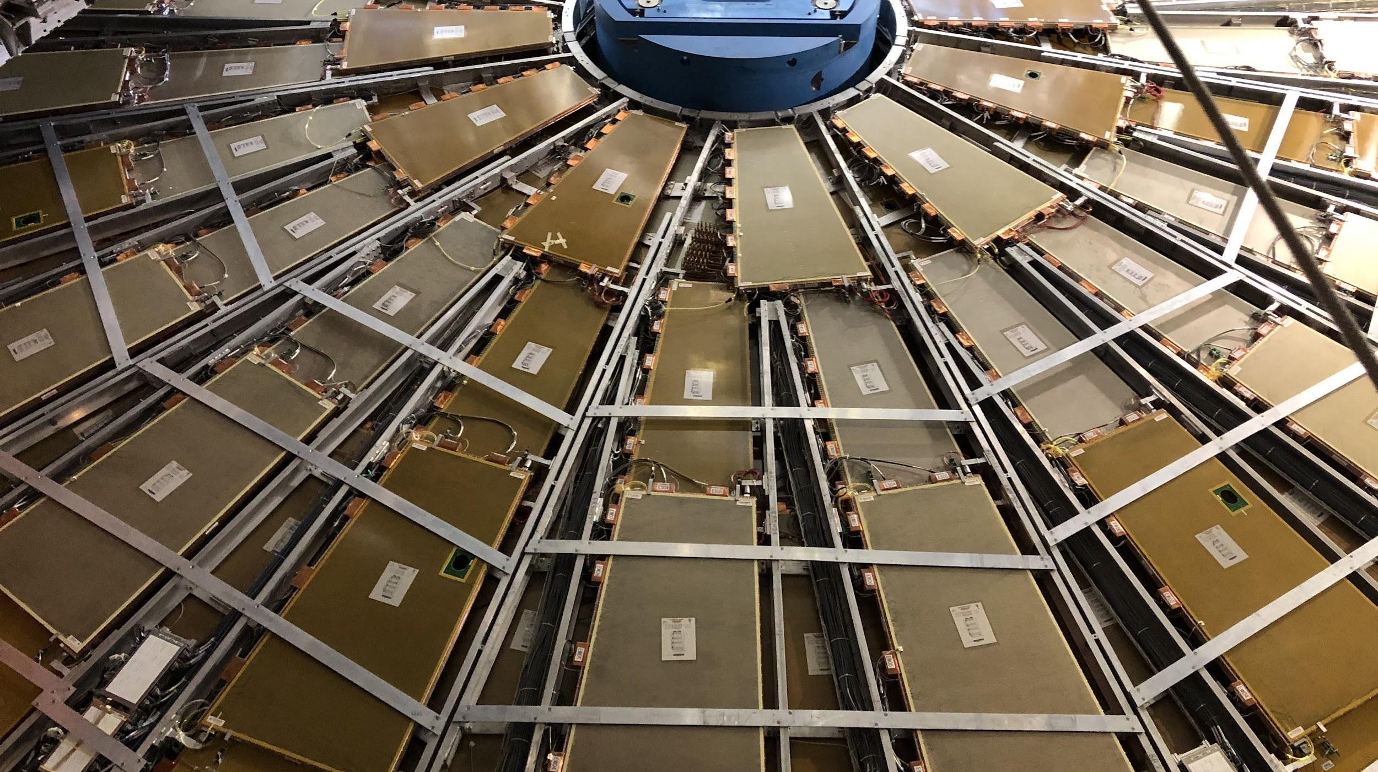

Maintenance Weekly
TileCal Op Meeting, 10 March 2022
Irakli Minashvili, Chris Thomas, Dawit Belayneh, Katie Hughes

Slide 2
MobiDick Testing (Mar. 11)
EBA25 (No CIS)
Confirmed no CIS response – DigShape is bad.
LBA02 (Dummy Error)
TTC and ROD connectors cleaned
On ROD connector we switched Ch2 and Ch4

Slide 3
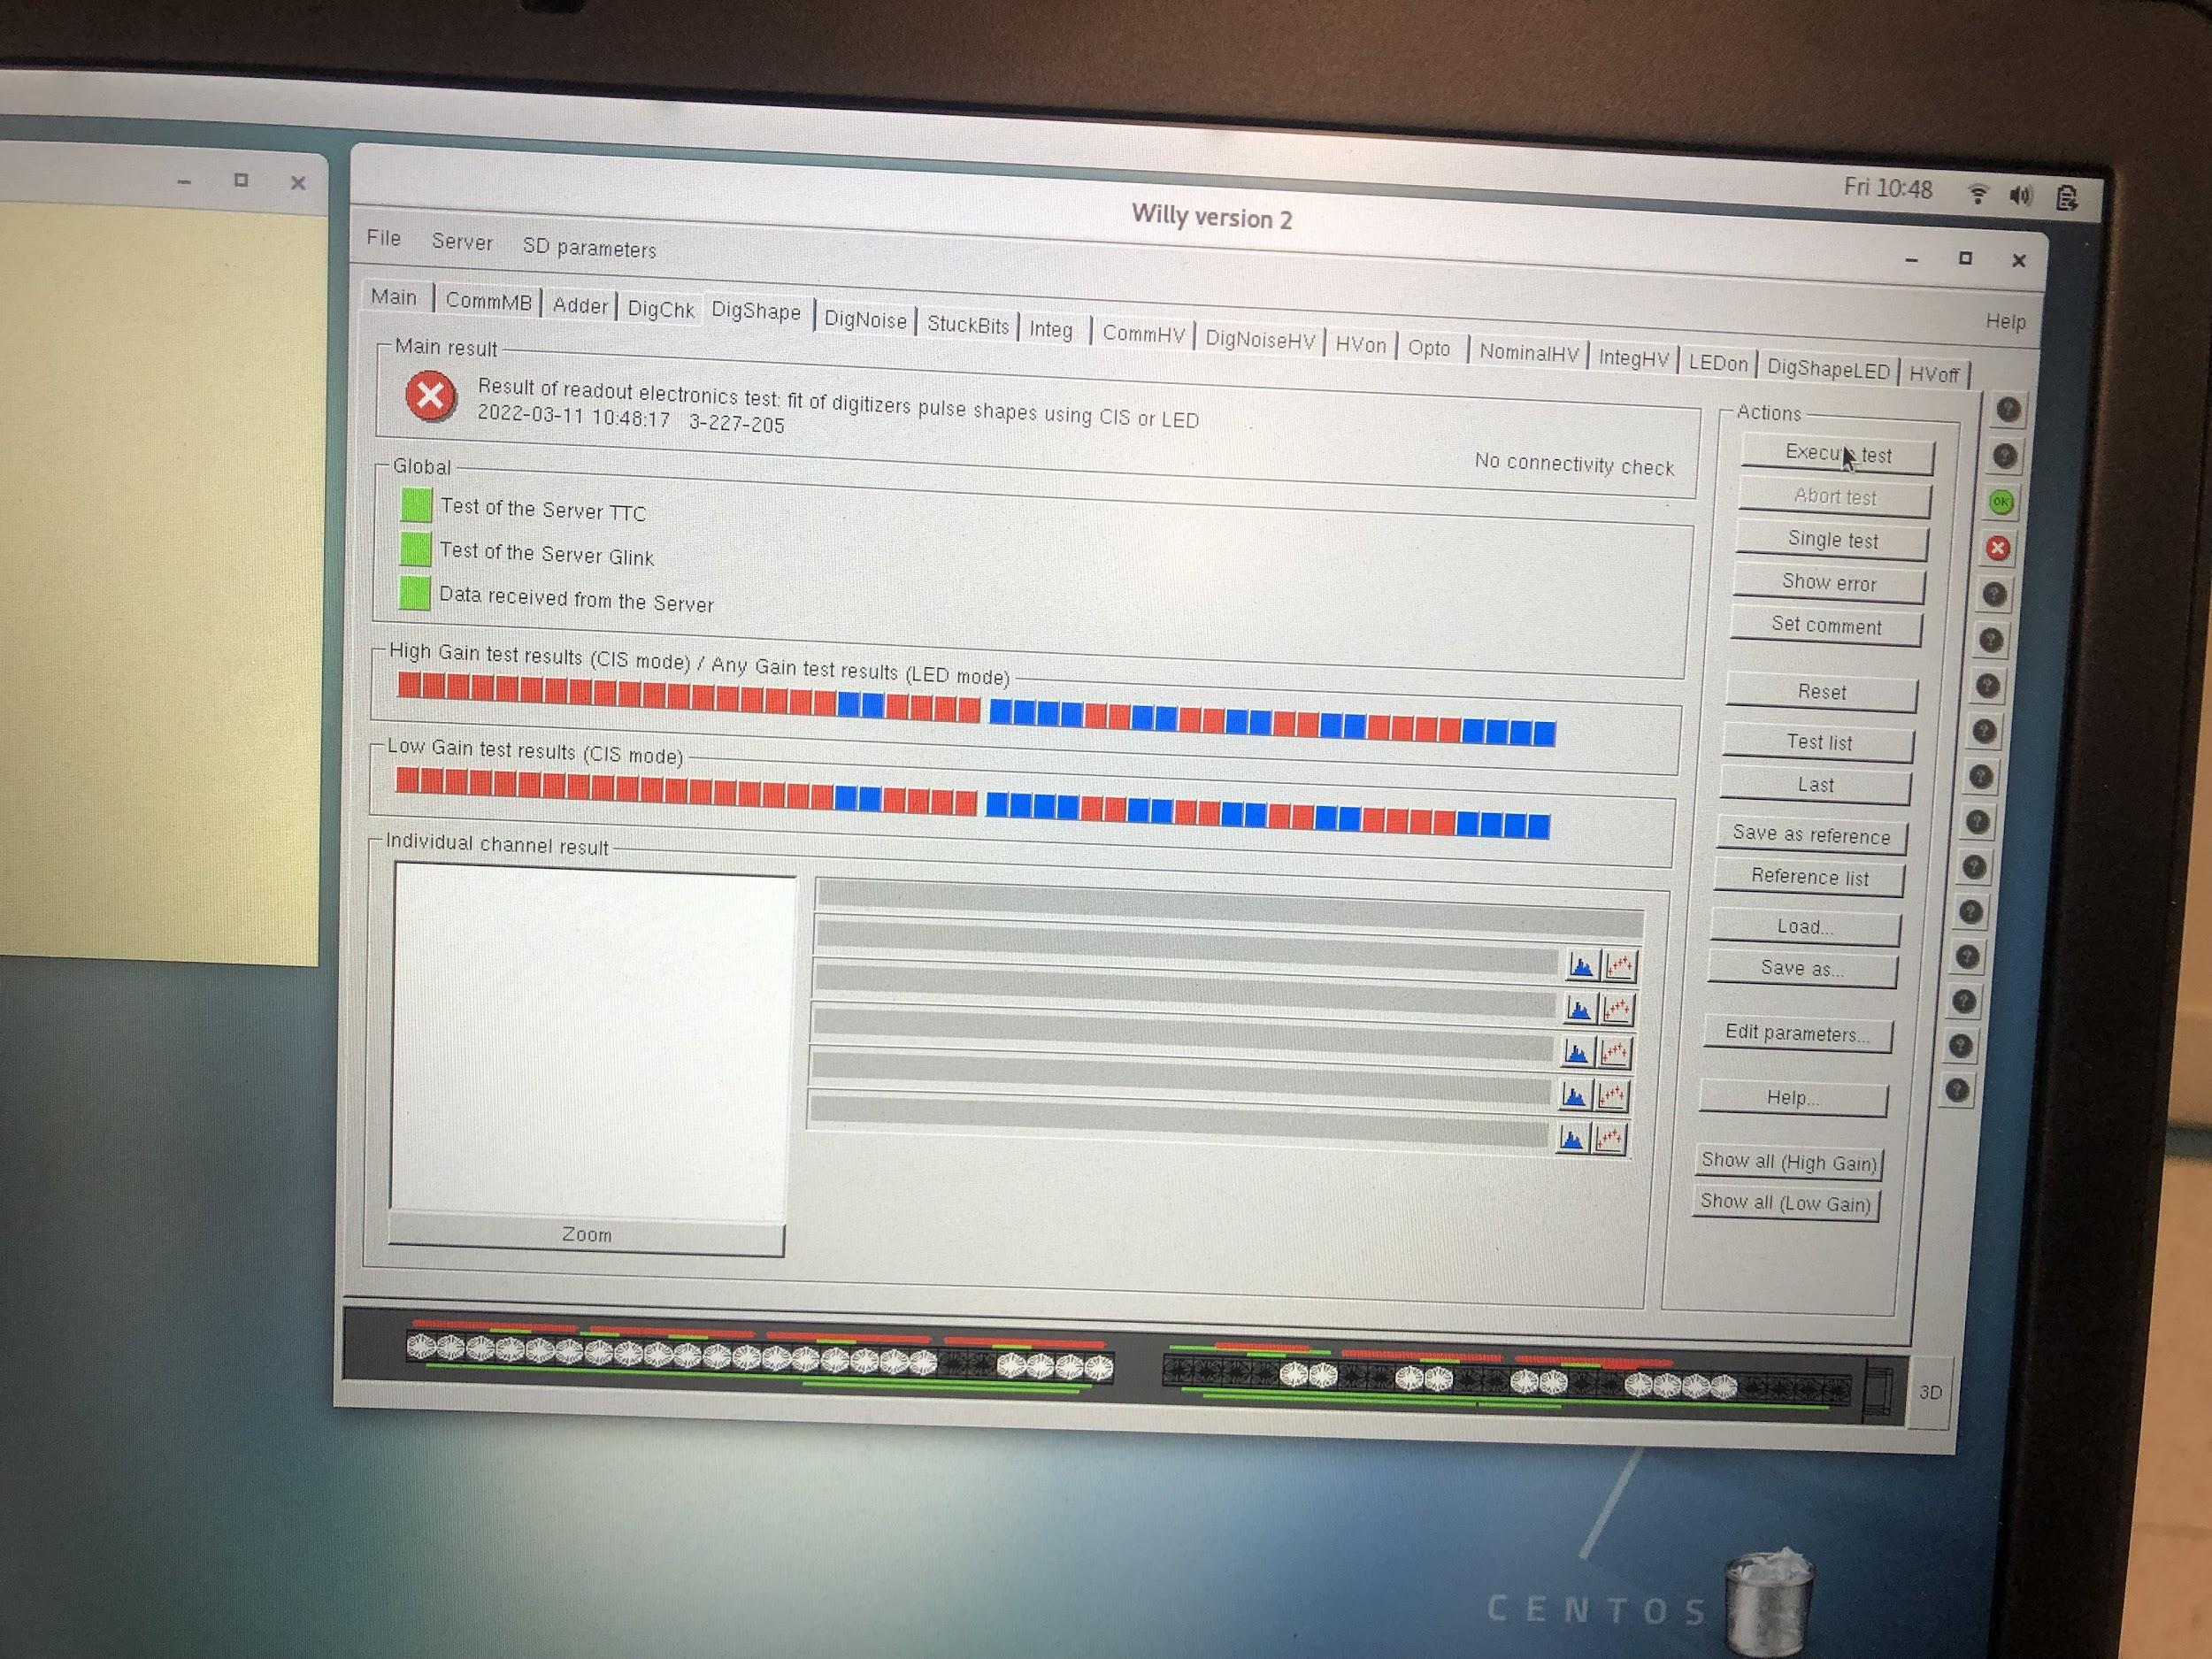
EBA25

